Slide 1

SAP UI5 training

Slide 2
Day 1

Slide 3
Agenda
SAPUI5 Overview
Programming Applications
SAPUI5 Development Tool Introduction
Performing an MVC Architecture Overview
Creating a SAPUI5 Project
Debugging Tools
Binding Data to a UI5 Control
Extended Data Binding Syntax
Resourcing Handling (Modularization and Localization)
Explaining Component File
Reviewing Descriptor for Application
3
CI/DAV1.5 | 2018-03-05
© Robert Bosch GmbH 2018. All rights reserved, also regarding any disposal, exploitation, reproduction, editing, distribution, as well as in the event of applications for industrial property rights.

Slide 4
SAPUI5 Overview
4
CI/DAV1.5 | 2018-03-05
© Robert Bosch GmbH 2018. All rights reserved, also regarding any disposal, exploitation, reproduction, editing, distribution, as well as in the event of applications for industrial property rights.

Slide 5
SAP UI Development Toolkit for HTML5
SAPUI5 Overview
SAP UI Development Toolkit for HTML5 The official long name
SAPUI5 The short name
UI5 Internal name
For official communication the upper two versions have to be used.
UI5 used to be named "Phoenix", it was changed to SAPUI5 in the summer of 2011 because the name Phoenix was not suitable to be used publicly.
5
CI/DAV1.5 | 2018-03-05
© Robert Bosch GmbH 2018. All rights reserved, also regarding any disposal, exploitation, reproduction, editing, distribution, as well as in the event of applications for industrial property rights.

Slide 6
Main UI5 Characteristics
SAPUI5 Overview
SAPUI5 is an extensible JavaScript-based HTML5 browser rendering library for Business Applications.
well-designed API, easy to consume and use
extensible UI component model, including tooling support
high performance, SAP product standard compliant
powerful theming support based on CSS
provides Ajax capabilities
based on open standards like OpenAjax, Javascript, CSS, HTML 5, etc.
using and including the popular jQuery library
6
CI/DAV1.5 | 2018-03-05
© Robert Bosch GmbH 2018. All rights reserved, also regarding any disposal, exploitation, reproduction, editing, distribution, as well as in the event of applications for industrial property rights.

Slide 7
UI5 Key Components
SAPUI5 Overview
Run Time
Control libraries (JavaScript, CSS and image files)
Core (JavaScript files)
Test suite (HTML, JavaScript files)
Design Time (optional)
Application development tools in Eclipse
Control development tools in Eclipse
Resource handler in Java and ABAP
Theming generator
7
CI/DAV1.5 | 2018-03-05
© Robert Bosch GmbH 2018. All rights reserved, also regarding any disposal, exploitation, reproduction, editing, distribution, as well as in the event of applications for industrial property rights.

Slide 8




UI5 Browser Support
SAPUI5 Overview
Internet Explorer Version 8 and upwards (with limitations)*
Firefox Version 10 and upwards Version 10 ESR and upwards
Chrome Version 1 and upwards
Safari Version 3 and upwards
*Internet Explorer 8 is supported with graceful degradation for CSS3 features like rounded corners, text-shadows, etc.
8
CI/DAV1.5 | 2018-03-05
© Robert Bosch GmbH 2018. All rights reserved, also regarding any disposal, exploitation, reproduction, editing, distribution, as well as in the event of applications for industrial property rights.

Slide 9
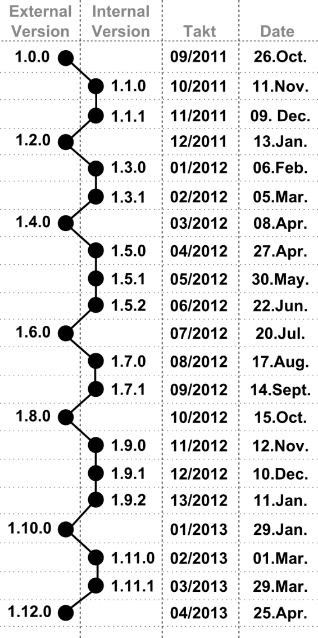
UI5 Release Plan
SAPUI5 Overview
Development track
Identified by a major and an odd minor version number, e.g. 1.5.1
The versions of this track are released internally and are not meant to be used in products shipped to customers.
Release track
Identified by a major and an even minor version number, e.g. 1.4.1
The versions of this track are released externally. Only these versions are allowed to be used in production.
9
CI/DAV1.5 | 2018-03-05
© Robert Bosch GmbH 2018. All rights reserved, also regarding any disposal, exploitation, reproduction, editing, distribution, as well as in the event of applications for industrial property rights.

Slide 10
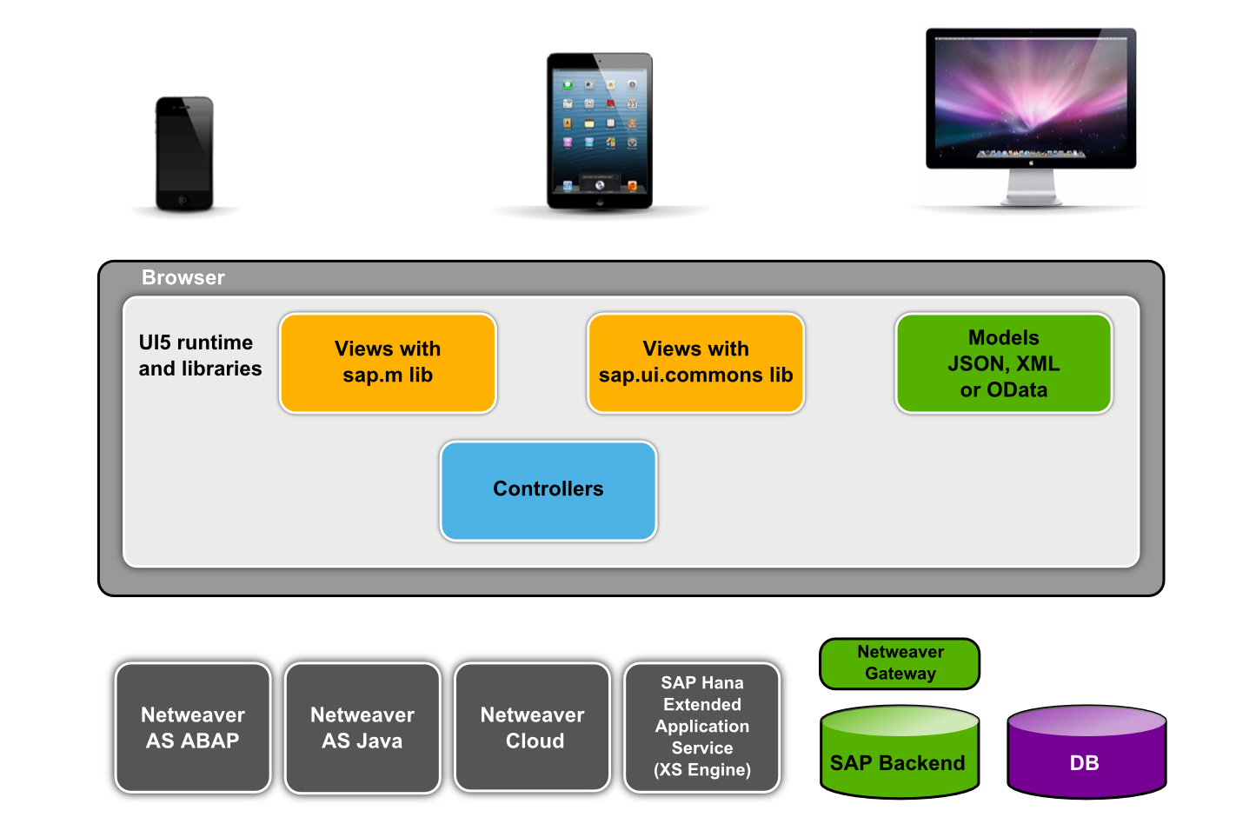
UI5 Architecture Overview
SAPUI5 Overview
Application
CLIENT
Application
SERVER
10
CI/DAV1.5 | 2018-03-05
© Robert Bosch GmbH 2018. All rights reserved, also regarding any disposal, exploitation, reproduction, editing, distribution, as well as in the event of applications for industrial property rights.

Slide 11
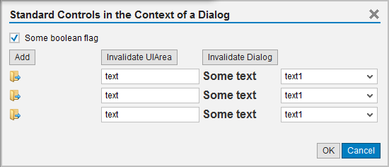
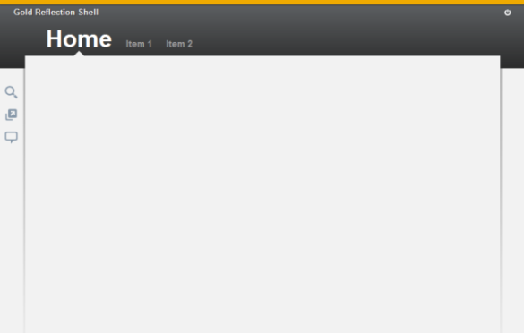
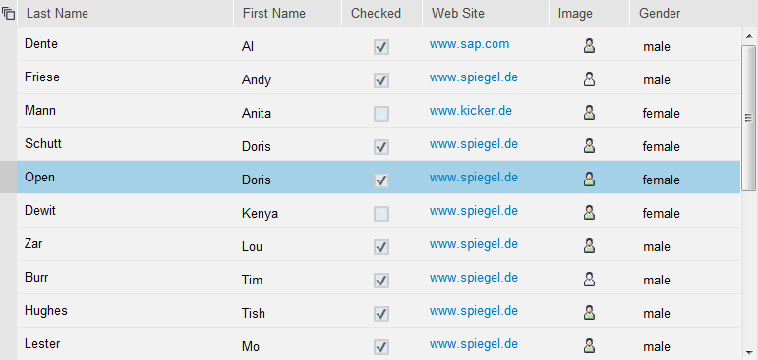
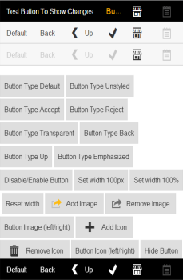
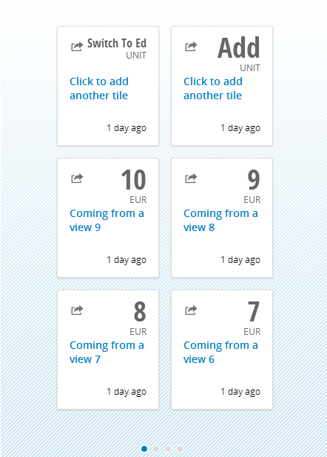
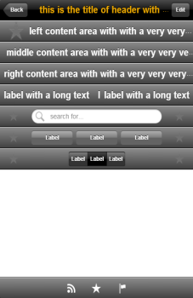
UI5 Control Libraries
sap.ui.commons
Includes “bread and butter" controls like TextField, Button
sap.ui.ux3 Includes UX3 patterns, mainly available in
“Gold Reflection” design, e.g.: Shell
sap.ui.table
Includes the Table control
sap.m
Includes controls for mobile devices
And more, like sap.viz, sap.ui.dev …
11
CI/DAV1.5 | 2018-03-05
© Robert Bosch GmbH 2018. All rights reserved, also regarding any disposal, exploitation, reproduction, editing, distribution, as well as in the event of applications for industrial property rights.

Slide 12
UI5 and Extensibility
Header of section
UI5 allows application developers to
Include their own JavaScript, HTML and CSS into UI5 based pages
Include other JavaScript libraries where UI5 is lacking controls or functionality
Create composite controls from existing UI5 controls
Write new UI libraries and new controls
Write plug-ins for the UI5 core
This way UI5 development groups should not become a bottleneck for application groups in need of a certain functionality.
12
CI/DAV1.5 | 2018-03-05
© Robert Bosch GmbH 2018. All rights reserved, also regarding any disposal, exploitation, reproduction, editing, distribution, as well as in the event of applications for industrial property rights.

Slide 13
UI5 Knowledge and Resources
Header of section
Documentation and Information
Demokit
API Documentation
Bosch Communities
SAP UI
SAP Fiori
Development Tools
SAP Web IDE
Eclipse
13
CI/DAV1.5 | 2018-03-05
© Robert Bosch GmbH 2018. All rights reserved, also regarding any disposal, exploitation, reproduction, editing, distribution, as well as in the event of applications for industrial property rights.

Slide 14
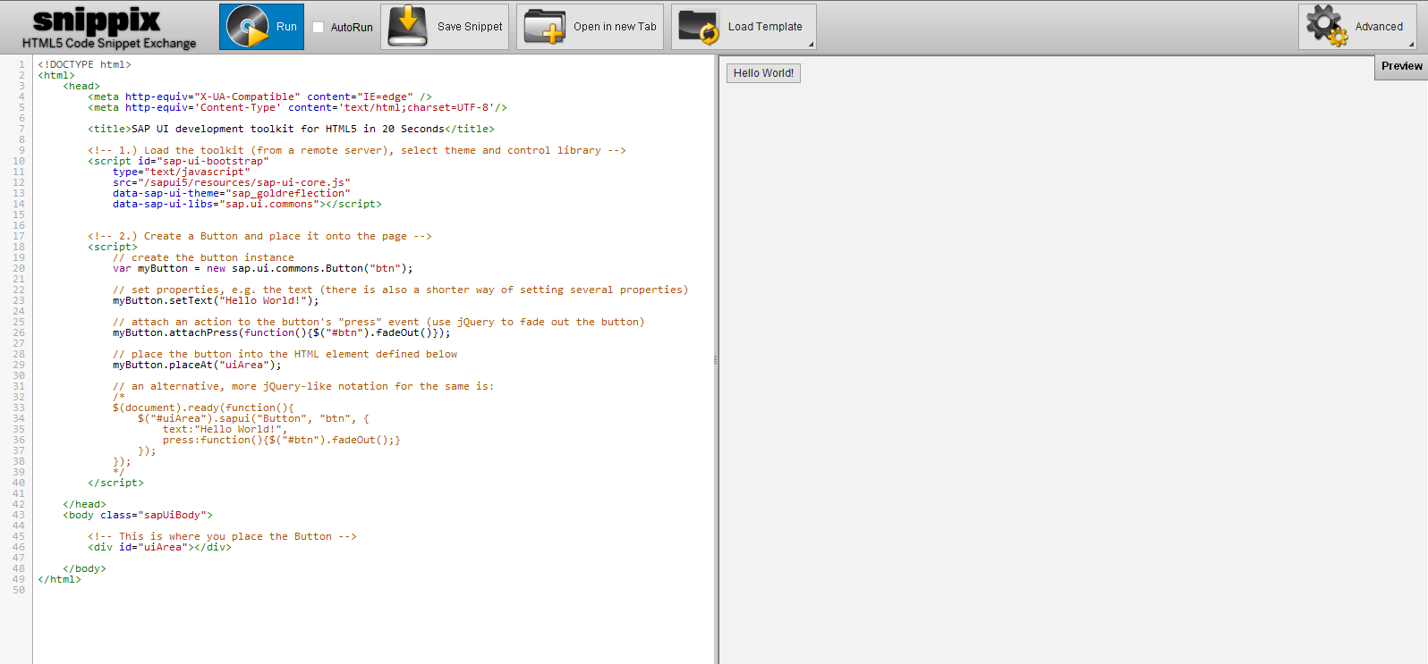
UI5 Application Example
Header of section
14
CI/DAV1.5 | 2018-03-05
© Robert Bosch GmbH 2018. All rights reserved, also regarding any disposal, exploitation, reproduction, editing, distribution, as well as in the event of applications for industrial property rights.

Slide 15
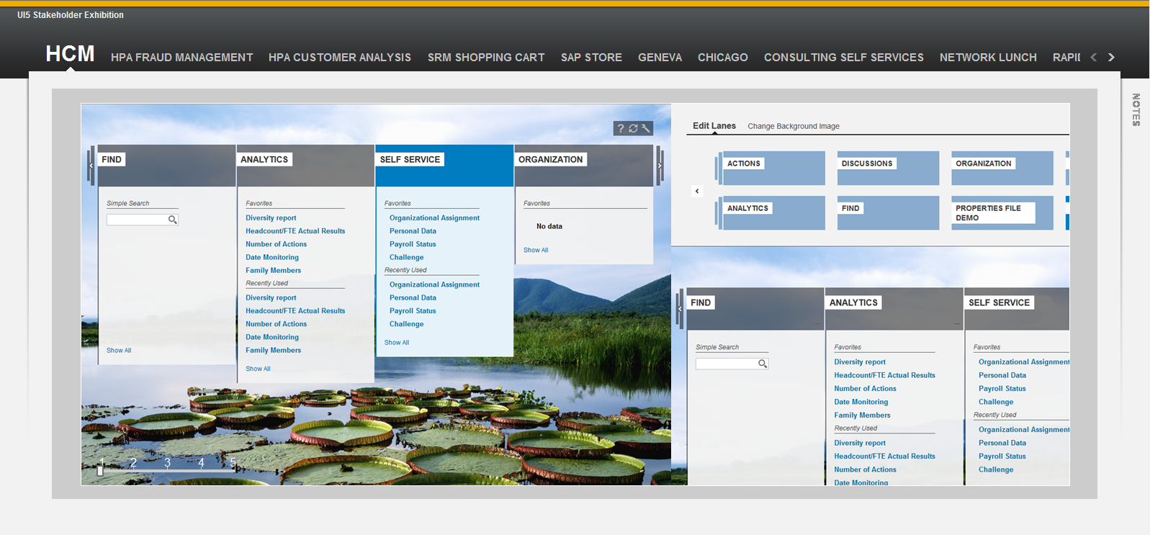
UI5 Application Example
Header of section
15
CI/DAV1.5 | 2018-03-05
© Robert Bosch GmbH 2018. All rights reserved, also regarding any disposal, exploitation, reproduction, editing, distribution, as well as in the event of applications for industrial property rights.

Slide 16
Programming Applications
16
CI/DAV1.5 | 2018-03-05
© Robert Bosch GmbH 2018. All rights reserved, also regarding any disposal, exploitation, reproduction, editing, distribution, as well as in the event of applications for industrial property rights.

Slide 17
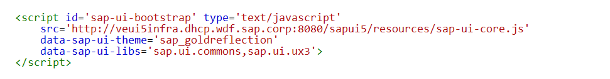
SAPUI5 bootstrap
Header of section
UI5 pages always have to start with the bootstrap, to load the UI5 runtime.
Attributes of the script tag are evaluated and used to configure the runtime
data-sap-ui-libs: the controls libraries to be used, comma-separated
data-sap-ui-theme: the theme
There are more attributes: data-sap-ui-language, data-sap-ui-rtl, …
Instead of putting the attributes in the script tag, many can also be added as URL parameters
17
CI/DAV1.5 | 2018-03-05
© Robert Bosch GmbH 2018. All rights reserved, also regarding any disposal, exploitation, reproduction, editing, distribution, as well as in the event of applications for industrial property rights.

Slide 18
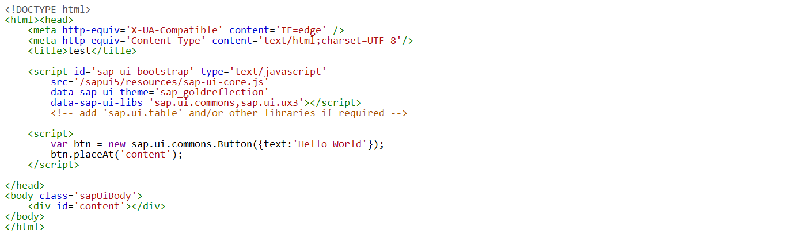
Application script and UI Area
Header of section
Exercise 1
After the bootstrap script tag an "application script" can follow in which the UI5 application is written
You create your controls like layouts and TextFields
Display your controls in an HTML element called "UI area" by invoking the placeAt method (there can be multiple UI areas)
1. Bootstrap
2. Application
3. UI-Area
18
CI/DAV1.5 | 2018-03-05
© Robert Bosch GmbH 2018. All rights reserved, also regarding any disposal, exploitation, reproduction, editing, distribution, as well as in the event of applications for industrial property rights.

Slide 19
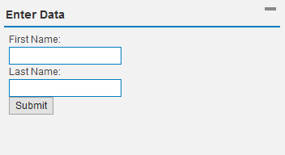
Exercise 1 – Create a Simple Application
Open SAP WEBIDE in your browser
Create a new sap.ui.commons.Panel and set its „text“ to „Enter Data“
Create a VerticalLayout with two Labels, two TextFields and a Button
new sap.ui.commons.layout.VerticalLayout
new sap.ui.commons.Label (text: „First Name“ / „Last Name“)
new sap.ui.commons.TextField
new sap.ui.commons.Button (text: „Submit“)
Add the Labels, the TextFields and the Button to the Layout
Add the Layout to the Panel using the addContent() method
Add a press handler to the Button that displays the values of the TextFields.
attachPress(function() {…})
getValue()
Solution

Slide 20
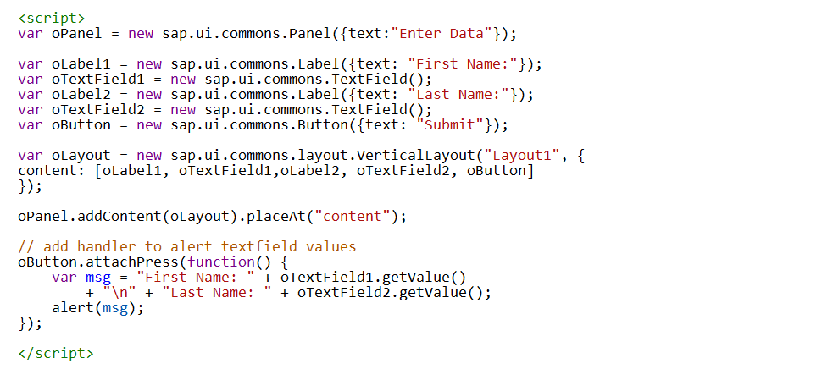
Solution for Exercise 1
Back
Notes:
var oPanel = new sap.ui.commons.Panel({text:"Enter Data"});
var oLabel1 = new sap.ui.commons.Label({text: "First Name:"});
var oTextField1 = new sap.ui.commons.TextField();
var oLabel2 = new sap.ui.commons.Label({text: "Last Name:"});
var oTextField2 = new sap.ui.commons.TextField();
var oButton = new sap.ui.commons.Button({text: "Submit"});
var oLayout = new sap.ui.commons.layout.VerticalLayout("Layout1", {
content: [oLabel1, oTextField1,oLabel2, oTextField2, oButton]
});
oPanel.addContent(oLayout).placeAt("content");
// add handler to alert textfield values
oButton.attachPress(function() {
var msg = "First Name: " + oTextField1.getValue()
+ "\n" + "Last Name: " + oTextField2.getValue();
alert(msg);
});

Slide 21
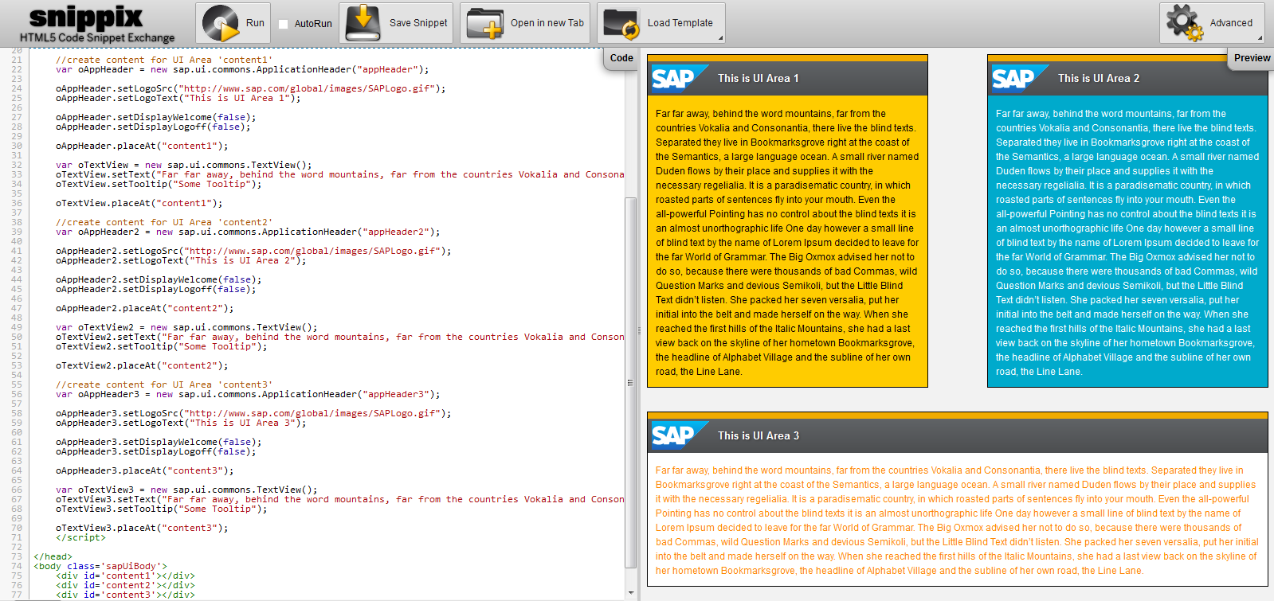
Example of Multiple UI Areas
Exercise 2
21
CI/DAV1.5 | 2018-03-05
© Robert Bosch GmbH 2018. All rights reserved, also regarding any disposal, exploitation, reproduction, editing, distribution, as well as in the event of applications for industrial property rights.
http://veui5infra.dhcp.wdf.sap.corp:8080/snippix/snippets/11571

Slide 22
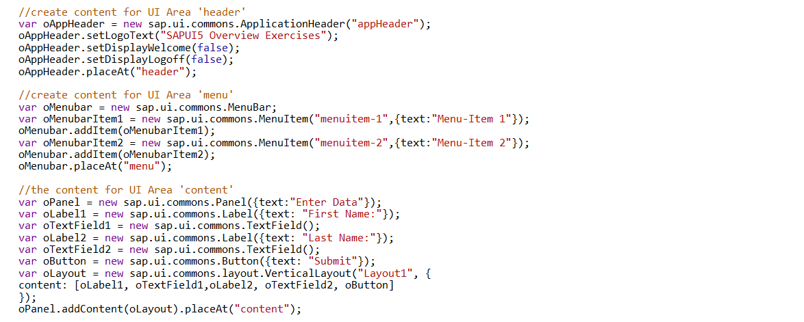
Solution for Exercise 2
Back
http://veui5infra.dhcp.wdf.sap.corp:8080/snippix/snippets/97068
Notes:
<!DOCTYPE html>
<html><head>
<meta http-equiv='X-UA-Compatible' content='IE=edge' />
<meta http-equiv='Content-Type' content='text/html;charset=UTF-8'/>
<title>test</title>
<script id='sap-ui-bootstrap' type='text/javascript'
src='/sapui5/resources/sap-ui-core.js'
data-sap-ui-theme='sap_goldreflection'
data-sap-ui-libs='sap.ui.commons,sap.ui.ux3'></script>
<!-- add 'sap.ui.table' and/or other libraries if required -->
<script>
//create content for UI Area 'header'
var oAppHeader = new sap.ui.commons.ApplicationHeader("appHeader");
oAppHeader.setLogoText("SAPUI5 Overview Exercises");
oAppHeader.setDisplayWelcome(false);
oAppHeader.setDisplayLogoff(false);
oAppHeader.placeAt("header");
//create content for UI Area 'menu'
var oMenubar = new sap.ui.commons.MenuBar;
var oMenubarItem1 = new sap.ui.commons.MenuItem("menuitem-1",{text:"Menu-Item 1"});
oMenubar.addItem(oMenubarItem1);
var oMenubarItem2 = new sap.ui.commons.MenuItem("menuitem-2",{text:"Menu-Item 2"});
oMenubar.addItem(oMenubarItem2);
oMenubar.placeAt("menu");
//the content for UI Area 'content'
var oPanel = new sap.ui.commons.Panel({text:"Enter Data"});
var oLabel1 = new sap.ui.commons.Label({text: "First Name:"});
var oTextField1 = new sap.ui.commons.TextField();
var oLabel2 = new sap.ui.commons.Label({text: "Last Name:"});
var oTextField2 = new sap.ui.commons.TextField();
var oButton = new sap.ui.commons.Button({text: "Submit"});
var oLayout = new sap.ui.commons.layout.VerticalLayout("Layout1", {
content: [oLabel1, oTextField1,oLabel2, oTextField2, oButton]
});
oPanel.addContent(oLayout).placeAt("content");
// add handler to alert textfield values
oButton.attachPress(function() {
var msg = "First Name: " + oTextField1.getValue()
+ "\n" + "Last Name: " + oTextField2.getValue();
alert(msg);
});
</script>
</head>
<body class='sapUiBody'>
<div id='header'></div>
<div id='menu'></div>
<div id='content'></div>
</body>
</html>

Slide 23
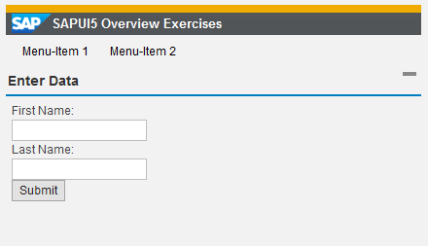
Exercise 2 – Create Multiple Areas
Open SAP WEBIDE in your browser and load your solution from Exercise 1
Create 2 additional UI Areas above the „content“ UI Area and name them „header“ and „menu“
Create an new sap.ui.commons.ApplicationHeader, set the Welcome Message setDisplayWelcome() and the Logoff setDisplayLogoff() to false and place it in the „header“ UI Area
Create a Menubar with 2 Menu Items and place it in the „menu“ UI Area
new sap.ui.commons.MenuBar
new sap.ui.commons.MenuItem
Solution
23
CI/DAV1.5 | 2018-03-05
© Robert Bosch GmbH 2018. All rights reserved, also regarding any disposal, exploitation, reproduction, editing, distribution, as well as in the event of applications for industrial property rights.

Slide 24
Solution for Exercise 2
Back
24
CI/DAV1.5 | 2018-03-05
© Robert Bosch GmbH 2018. All rights reserved, also regarding any disposal, exploitation, reproduction, editing, distribution, as well as in the event of applications for industrial property rights.

Slide 25
Useful Core Functions
Header of section
Exercise 3
sap.ui.getCore()
Gets a core instance
sap.ui.getCore().byId(id)
Gets an instance of a UI5 control which was created with id id
Can be used to access removed controls (even though the id doesn’t exist in the DOM anymore)
sap.ui.getCore().applyChanges()
Carries out and renders the changes for UI5 controls immediately, before the runtime would do it (use carefully!!)
jQuery.sap.domById(id)
Gets any HTML element with id id
If there is also a UI5 control with id id, the element returned is the topmost HTML element of this UI5 control (the UI5 control id is always used there)
Similar to document.getElementById but gets rid of IE bug which also retrieves elements with the name of id
jQuery.sap.byId(id)
Returns the jQuery object of the DOM element with the specified id
Similar to jQuery(„#myId“) or $(„#myId“) but handles escaping of dots and adds the hash character
25
CI/DAV1.5 | 2018-03-05
© Robert Bosch GmbH 2018. All rights reserved, also regarding any disposal, exploitation, reproduction, editing, distribution, as well as in the event of applications for industrial property rights.

Slide 26
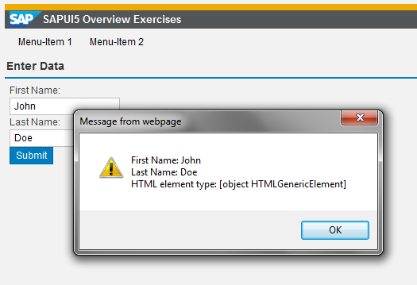
Exercise 3 – Core Functions
Open SNIPPIX in your browser and load snippet 97068 or your solution from Exercise 2.
For getting the TextField value when the button is pressed:
Do not use the TextField reference, but retrieve the TextField using its ID (you have to give an ID first):
sap.ui.getCore().byId(…).getValue()
Also alert the type of the HTML element which is the root element of the Panel control
The ID of a control is always the ID of the HTML element
Use jQuery.sap.domById(…)
Solution
26
CI/DAV1.5 | 2018-03-05
© Robert Bosch GmbH 2018. All rights reserved, also regarding any disposal, exploitation, reproduction, editing, distribution, as well as in the event of applications for industrial property rights.

Slide 27
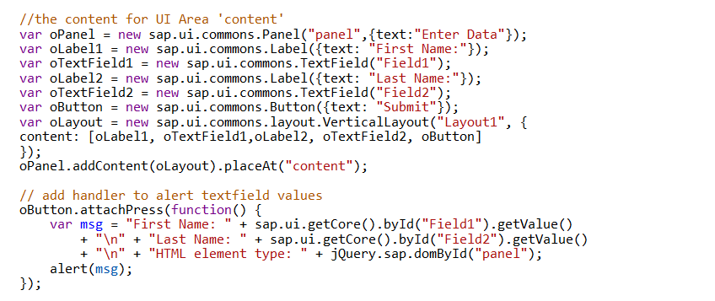
Solution for Exercise 3
Back
27
CI/DAV1.5 | 2018-03-05
© Robert Bosch GmbH 2018. All rights reserved, also regarding any disposal, exploitation, reproduction, editing, distribution, as well as in the event of applications for industrial property rights.

Slide 28
SAPUI5 Development Tool Introduction
28
CI/DAV1.5 | 2018-03-05
© Robert Bosch GmbH 2018. All rights reserved, also regarding any disposal, exploitation, reproduction, editing, distribution, as well as in the event of applications for industrial property rights.

Slide 29
SAP Web IDE
Header of section
SAP Web IDE is a web-based development environment that is optimized for developing SAPUI5 complex apps using the latest innovations, developing and extending SAP Fiori apps, developing mobile hybrid apps, and extending SAP Web IDE with plug-ins and templates.
Get a Trial Account and Access SAP
Start SAP Web IDE
29
CI/DAV1.5 | 2018-03-05
© Robert Bosch GmbH 2018. All rights reserved, also regarding any disposal, exploitation, reproduction, editing, distribution, as well as in the event of applications for industrial property rights.

Slide 30
Eclipse
Header of section
Used for developing apps for simple use cases. The SAPUI5 application development tools for Eclipse provide wizards to support you in creating apps in an easy way. With the application project wizard, the necessary application skeleton containing views and controllers will automatically be created.
Installing SAPUI5 Tools for Eclipse
Using SAPUI5 Tools for Eclipse
30
CI/DAV1.5 | 2018-03-05
© Robert Bosch GmbH 2018. All rights reserved, also regarding any disposal, exploitation, reproduction, editing, distribution, as well as in the event of applications for industrial property rights.

Slide 31
Header of section
App Development Using OpenUI5
Node.js-Based Development Environment
31
CI/DAV1.5 | 2018-03-05
© Robert Bosch GmbH 2018. All rights reserved, also regarding any disposal, exploitation, reproduction, editing, distribution, as well as in the event of applications for industrial property rights.

Slide 32
Header of section
32
CI/DAV1.5 | 2018-03-05
© Robert Bosch GmbH 2018. All rights reserved, also regarding any disposal, exploitation, reproduction, editing, distribution, as well as in the event of applications for industrial property rights.

Slide 33
Header of section
33
CI/DAV1.5 | 2018-03-05
© Robert Bosch GmbH 2018. All rights reserved, also regarding any disposal, exploitation, reproduction, editing, distribution, as well as in the event of applications for industrial property rights.

Slide 34
34
CI/DAV1.5 | 2018-03-05
© Robert Bosch GmbH 2018. All rights reserved, also regarding any disposal, exploitation, reproduction, editing, distribution, as well as in the event of applications for industrial property rights.

